Slide 1
Artificial intelligence, firm growth, and product innovation
Tania Babina
Columbia University
Anastassia Fedyk
University of California
Alex He
University of Maryland
James Hodson
AI for Good Foundation, Berkeley
Institut Jožef Stefan, Ljubljana, Slovenia
Journal of Financial Economics
November 2023
Presented by: Yan Li

Slide 2
Research Goal
To study how firms invest in and benefit from one of the most important new technologies of the last decade—artificial intelligence

Slide 3
Literature Contribution
The paper provides one of the first pieces of systematic evidence on how investments in artificial intelligence relate to firm and industry outcomes. Recent work makes progress in examining the impact of AI technologies on firm activities in various specific settings: robo-advising (D’Acunto et al., 2019), fintech innovation (Chen et al., 2019), loan underwriting (Jansen et al., 2020; Fuster et al., 2020), financial analysts (Grennan and Michaely, 2019; Abis and Veldkamp, 2023; Cao et al., 2021), and entrepreneurship (Gofman and Jin, 2022).
Methodologically, the paper offers a new approach to measure firms’ intangible capital based on human capital, with a specific application to capturing investments in AI. Most firm-level measures of intangible capital use cost items such as R&D and SG&A (e.g., Eisfeldt and Papanikolaou, 2013; Peters and Taylor, 2017; Crouzet and Eberly, 2019; Eisfeldt et al., 2020).
Finally, the paper contributes to the recent literature on industry concentration and superstar firms (e.g., Gutiérrez and Philippon, 2017; Covarrubias et al., 2019; Grullon et al., 2019; Autor et al., 2020). Previous literature documents that larger firms adopt more IT and Internet technologies and benefit more from them (Forman, 2005; Brynjolfsson et al., 2008, 2023; Bessen, 2020). Our findings suggest that new technologies like AI have similar scale advantages and may be an important driver of the superstar firms phenomenon.

Slide 4
Artificial intelligence and firm growth: mechanisms
AI as a Driver of Product Innovation.
First, the ability of AI algorithms to quickly analyze large datasets and learn about the underlying relationships from data can potentially reduce the uncertainty of experimentation and make the learning process more efficient, which leads to more experimentation and creation of new products (Cockburn et al., 2018).
Second, AI algorithms can help innovate on the quality of existing products and services by building AI models directly into products.
Third, AI can also improve product appeal by helping firms learn about customer preferences more efficiently and therefore better tailor product and service offerings to customers’ tastes and needs.
AI as a Driver of Process Innovation and Lower Operating Costs
First, AI can potentially replace human labor for some tasks (Agrawal et al., 2019), cutting per-unit labor costs
Second, AI can increase operational and production efficiency through better forecasting (Mihet and Philippon, 2019).

Slide 5
Data and Sample
Cognism (an aggregator of employment profiles for lead generation and client relationship management services): a novel dataset of approximately 535 million individual profiles
The sample of 120 million person-firm-years matched to U.S. public firms is comprised of 19 million distinct individual employees.
Burning Glass Technologies and a rich set of sources: 180 million job postings in the United States in 2007 and 2010–2018
Additional data sources: commuting-zone-level wage and education data from the Census American Community Surveys (ACS), industry-level wages and employment data from the Census Quarterly Workforce Indicators (QWI), and academic publications from the Open Academic Graph. Firm-level operational variables (e.g., sales, employment, market value) come from Compustat.

Slide 6
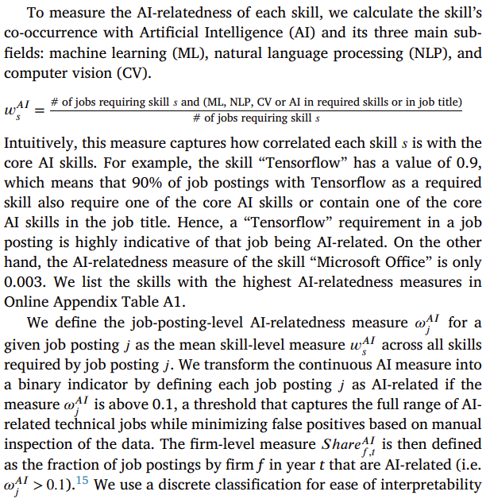



AI investments from job postings (Burning Glass)

Slide 7


AI investments from resumes (cognism)
The authors identify the employees in the Cognism resume data whose job positions directly involve AI. They begin with the set of 67 keywords, which are skills with the highest skill-level AI-relatedness measures based on job postings data. They search for these terms in each employment record of each individual in the resume data to see whether:
that job (role and description) directly includes any of the identified AI terms;
the individual obtained any patents during that year or the two following years with these AI terms;
the individual has any publications or awards during that year or the following year that include the identified AI terms.
If any of these conditions are met, then that person at that firm in that year is classified as an AI-related employee. For example, jobs with titles such as “senior machine learning developer” or job descriptions such as “develop chatbots using Python with Tensorflow and deep learning models” are identified as AI jobs.

Slide 8
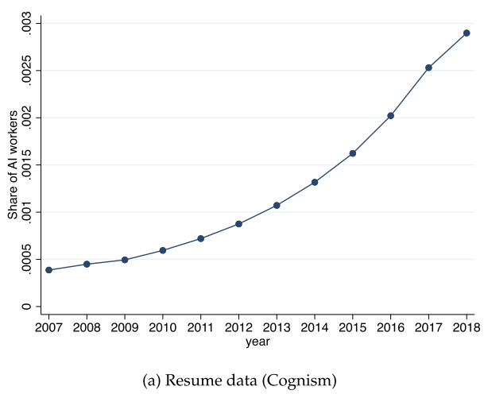
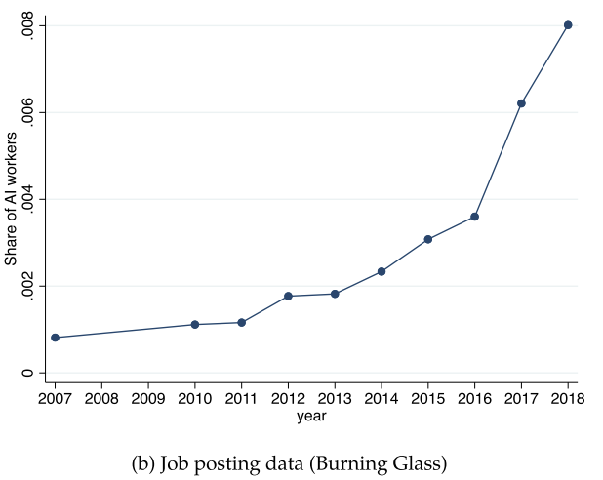
Summary statistics and validation
Panel (a) shows the fraction of all employees in a given year who are classified as holding AI-related positions in the Cognism resume data from 2007 to 2018. Panel (b) reports the fraction of job postings in the Burning Glass data (with job-level continuous AI measure above 0.1) for 2007 and 2010–2018.
Notes:
Panel (a) of Fig. 1 shows a rapid increase in the fraction of employees whom we classify as AI-related: this fraction starts at 0.04% in 2007 and reaches 0.29% in 2018.
Panel (b) shows analogous patterns in the job postings data: the fraction of AI-skilled job postings starts out at 0.1% in 2010, rises rapidly over time (with the increase speeding up from 2014 to 2018), and peaks at 0.8% in 2018.

Slide 9
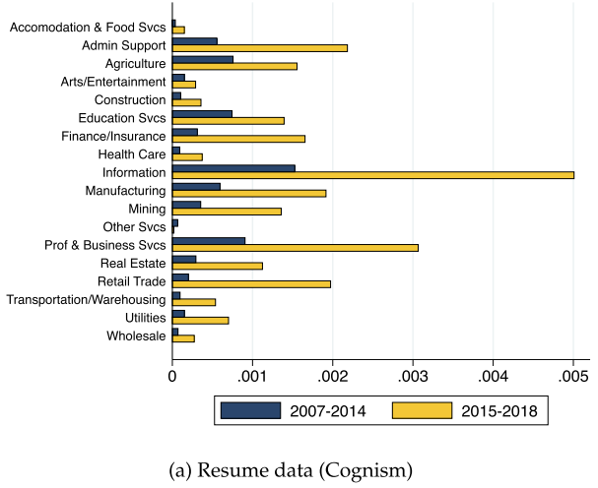
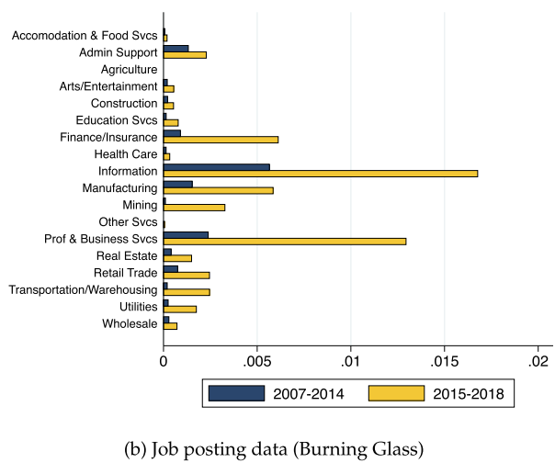
Summary statistics and validation
Fig. 2. presents the average share of AI jobs at the industry level, based on the sample of U.S. public firms. Panel (a) of Fig. 2 plots the average share of AI-related workers in the resume data for public firms in each of the 2-digit NAICS sectors, separately for the years 2007–2014 and 2015–2018. Panel (b) repeats the same analysis for the share of AI related job postings.
Notes:
The figure highlights that the share of AI-skilled jobs is highest in the “Information” sector, growing from 0.15% (0.57%) in the early years of 2007–2014 to 0.50% (1.68%) in the later period of 2015–2018. However, almost all sectors see a meaningful increase. The ability of our measures to pick up AI investments in a broad cross-section of economic sectors highlights a key advantage of our human-capital-based approach.

Slide 10
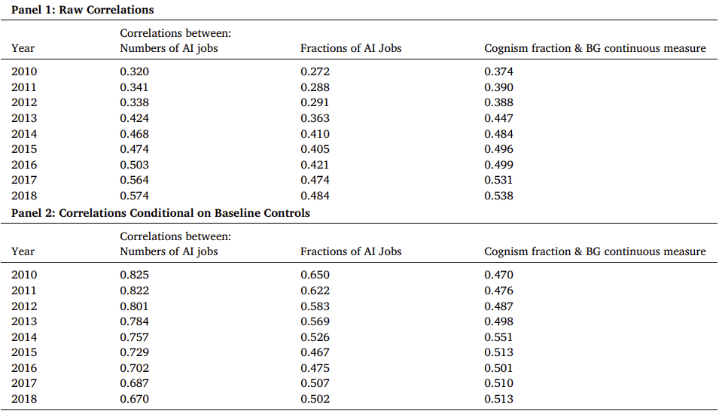
Summary statistics and validation
Table 1 Correlations between Job-posting-based and Resume-based AI Measures.
a high correlation between the authors’ measure of AI investments based on the novel resume data and on the job postings data.
The resume-based measure of AI investments offers a good proxy for firms’ actual AI hiring using the more widely accessible job postings data
Notes:
This table reports, for each year from 2010 to 2018, the Spearman rank correlations between three pairs of firm-level variables:
the absolute number of AI job postings in Burning Glass against the absolute number of AI employees in resumes from Cognism;
the fraction of employees classified as AI-related in the two datasets;
the fraction of AI employees in Cognism against the average continuous AI measure in Burning Glass.
Panel 1 shows raw correlations, and Panel 2 displays correlations conditional on the 2-digit NAICS industry sector fixed effects and the baseline controls.

Slide 11
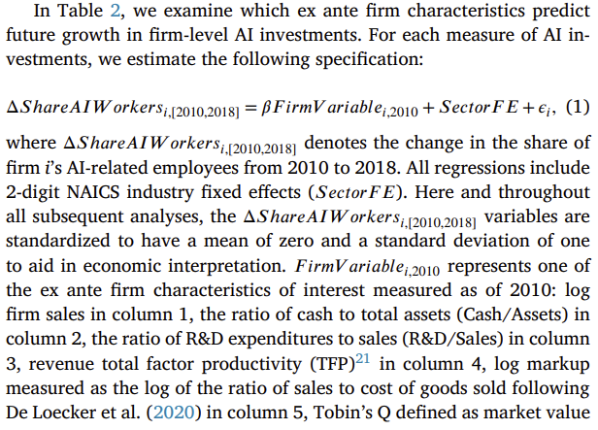
Firm-level determinants of AI investments

Slide 12
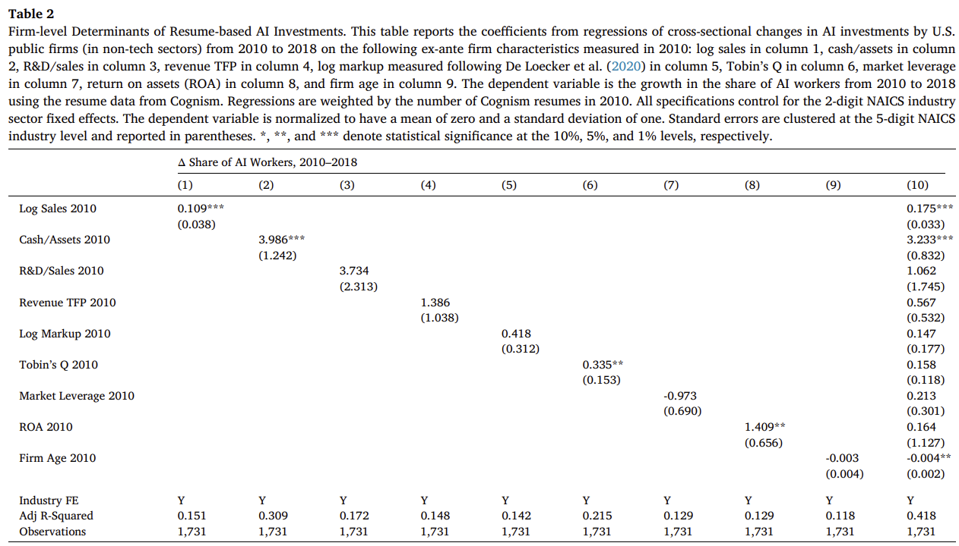






Firm-level determinants of AI investments
Notes:
log markup measured as the log of the ratio of sales to cost of goods sold.
The results reported in Table 2 highlight that ex ante larger firms experience higher growth in AI investments. A one-standard-deviation increase in log sales in 2010 corresponds to the share of AI workers increasing by 23% of the standard deviation from 2010 to 2018, significant at the 1% level. In addition, firms with higher starting Cash/Assets also see greater investments in AI, in both univariate and multivariate regressions. Younger firms also see greater investments in AI, but the relationship is not robust as this is observed in the multivariate regression. By contrast, R&D/Sales, revenue TFP, markups, firm valuation (Tobin’s Q), market leverage, and return on assets do not robustly predict future AI investments.

Slide 13
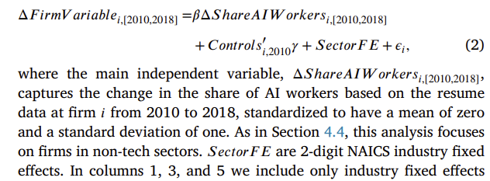




AI investments and firm growth(Long-differences results)

Slide 14
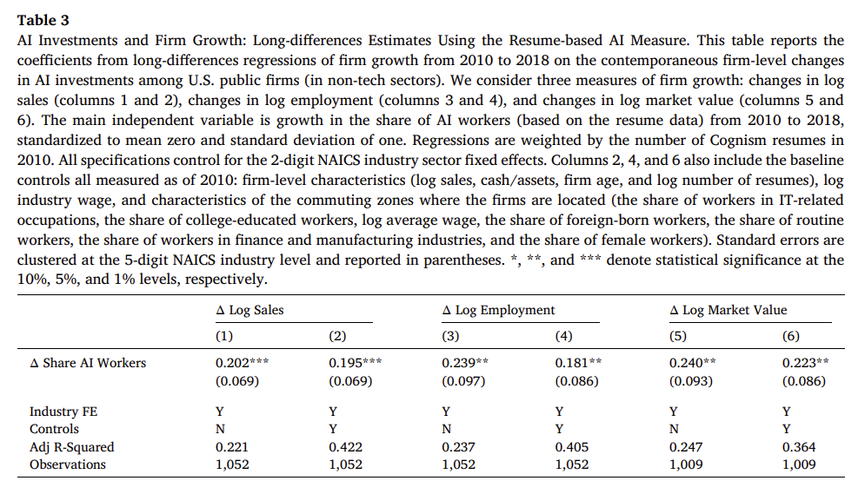
AI investments and firm growth(Long-differences results)
Notes:
Changes in AI investments are associated with a significant and economically meaningful increase in sales growth, employment growth, and stock market value growth.
Hiring AI-skilled labor can have a strong positive relationship with firm growth

Slide 15
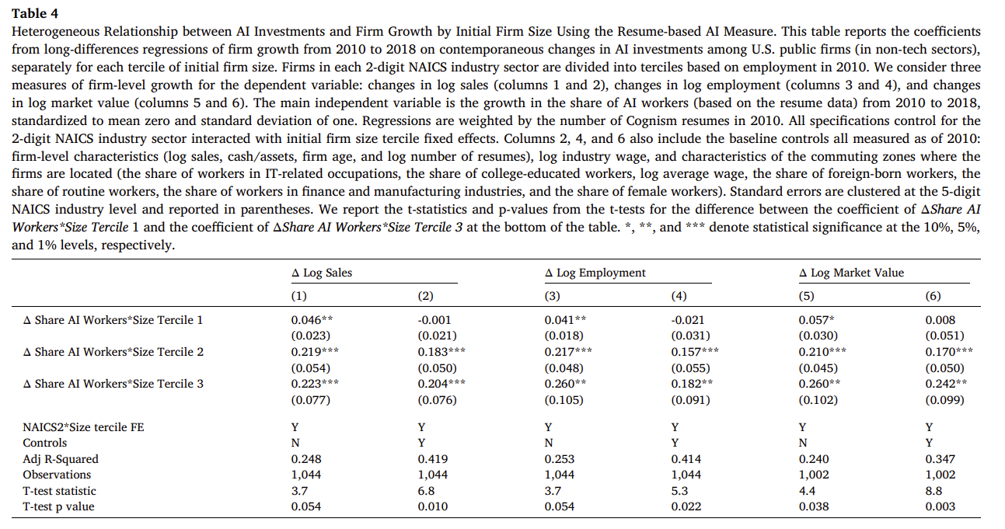
AI investments and firm growth(Long-differences results)
Notes:
Table 4 shows the relationship between changes in AI investments and firm growth, across terciles of firms by employment in 2010 (within the firm’s 2-digit NAICS sector), controlling for initial size and sector-by-size-tercile fixed effects.
The relationship between firm AI investments and firm growth is monotonically increasing in the firm’s initial size. The stronger positive relationship between changes in AI investments and growth among the ex ante larger firms is consistent with big data and AI technologies having scale effects that favor large firms, which accumulate large amounts of data as a by-product of their economic activity.
The results in Table 4 suggest that AI may provide a channel through which large firms can combat barriers to innovation and scale by leveraging their data assets.

Slide 16
Long-differences results Robustness
Alternative measures of AI investments.
The authors use the resume-based share of AI workers as the main measure of AI investments because the resume data address two important potential measurement concerns regarding job postings data: (i) the job-postings-based measure captures only firms’ demand for AI talent and not their actual ability to hire; and (ii) firms might obtain AI expertise through acquisitions, which would not be reflected in job postings but is captured in the Cognism resume data, which reflect actual employees, including those onboarded through acquisitions.
Results remain similar:
- when measuring AI using the Burning Glass job postings data
Instead of using standardized measures of AI investments, the authors also consider dummy variables indicating whether firms’ AI investments are in the top 10 percent or 25 percent of the distribution.
firms’ use of external AI solution (including IBM Watson, IPSoft Amelia, etc.)
Confounding factors
The estimates above may not reflect the effects of AI investments if contemporaneous changes at AI-investing firms lead to both increased investment in AI and higher firm growth
address the possibility that investments in AI are correlated with investments in other technologies (e.g., IT) by controlling for growth in: (i) investments in (non-AI) IT, (ii) investments in robots, (iii) investments in non-AI data skills (e.g., “Data Cleaning”), and (iv) investments in non-AI-related data analytics (e.g., “SAS”)
address the possibility that AI-investing firms may happen to experience positive demand shocks or higher growth trajectories by controlling for detailed industry fixed effects to absorb industry-specific shocks

Slide 17
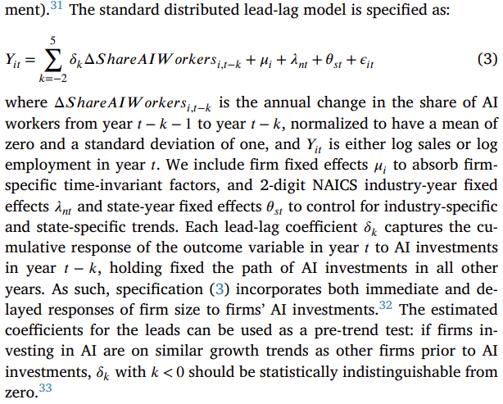
Dynamic relationship between firm AI investments and firm growth

Slide 18
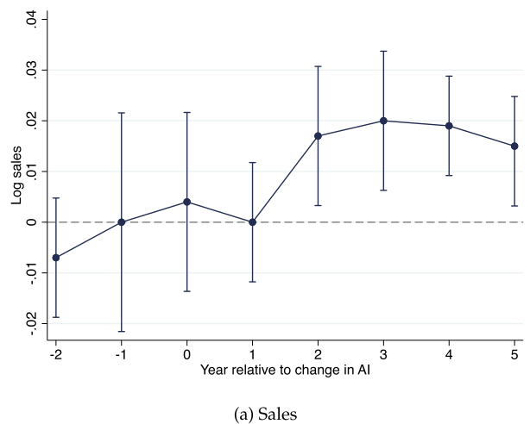
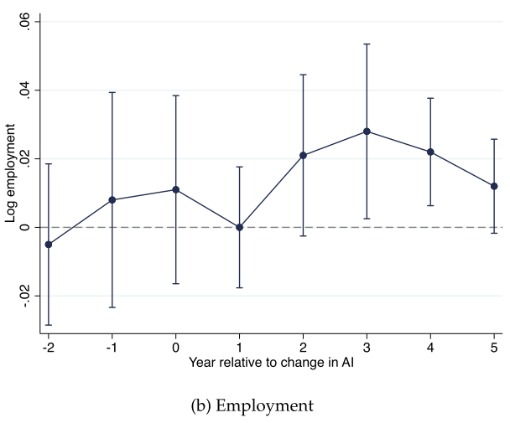
Dynamic relationship between firm AI investments and firm growth
Fig. 3 reports the coefficients from the lead-lag regressions. Panel A shows that sales increase following AI investments, but not immediately—it takes two to three years for firms to realize the benefits from AI investments. Panel B shows that AI investments are associated with a similar increase in firms’ employment

Slide 19
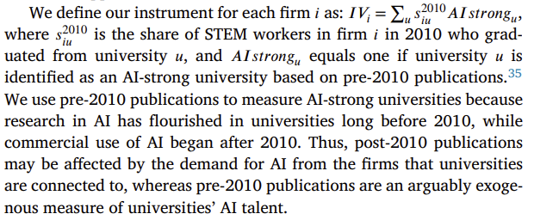
Instrumental variable estimates
To construct the instrument, the authors compile two datasets on: (i) the ex-ante strength of AI research in each university, and (ii) firm-university hiring networks.
To identify universities strong in AI research before 2010, the authors use data from the Open Academic Graph (OAGv2).
To construct the firm-university hiring networks by leveraging the resume data to observe the universities granting the degrees of each firm’s employees

Slide 20
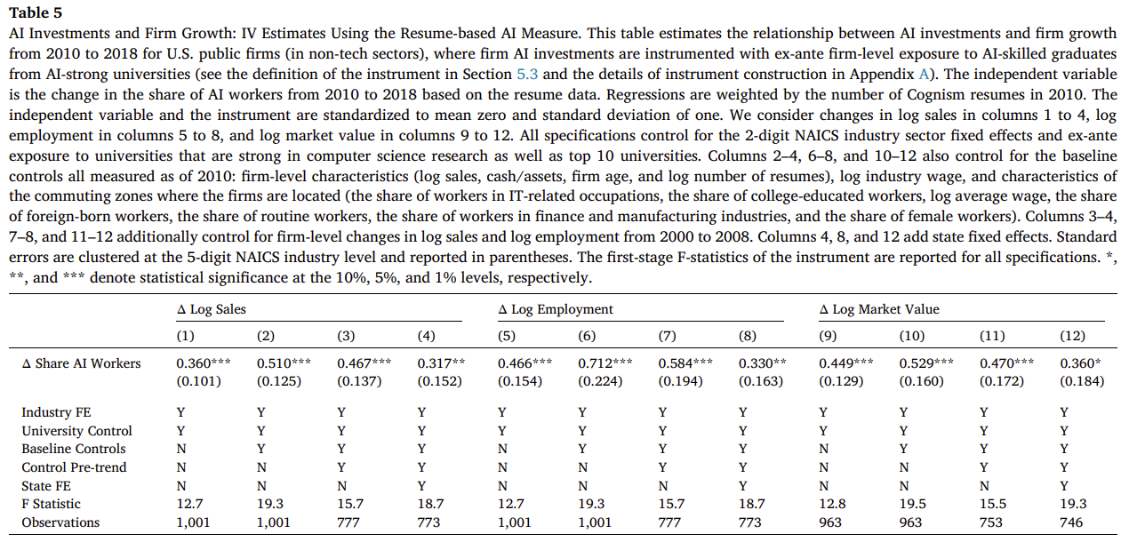
Instrumental variable estimates
Notes:
Table 5 presents the 2SLS estimates. The results show a robust and significant effect of AI investments on sales (columns 1–4), employment (columns 5–8), and market value (columns 9–12). When all controls are included, a one-standard-deviation increase in AI investments leads to a 32% increase in sales, a 33% increase in employment, and a 36% increase in stock market valuations.
The magnitudes are about 50% larger than OLS estimates, which may be due to measurement error or a negative bias from firms with lower opportunity costs of innovation and lower growth prospects investing in AI.36 It is important to note, however, that the OLS and IV coefficients are not statistically different. This suggests that the difference between the point estimates could also be driven by estimation error.

Slide 21
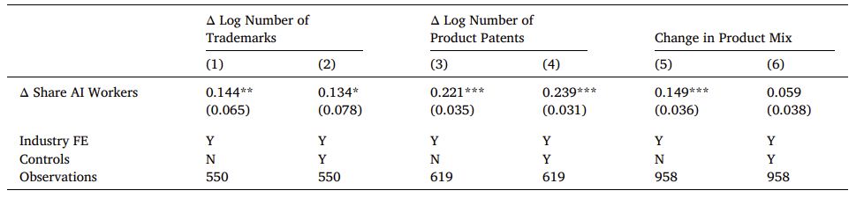
AI as a driver of product innovation
Table 6 AI Investments and Product Innovation Using the Resume-based AI Measure
Notes:
Columns 1 and 2 shows that AI-investing firms significantly increase their trademark portfolios. A one-standard-deviation increase in the share of AI workers is associated with approximately 13% more trademarks.
Columns 3 and 4 reveal a similar relationship between AI investments and the number of product patents, which are patents specifically focusing on product innovations.
In column 5, we find that growth in AI investments is associated with increased changes in firms’ product mix, but the relationship becomes statistically insignificant when adding additional controls in column 6.

Slide 22
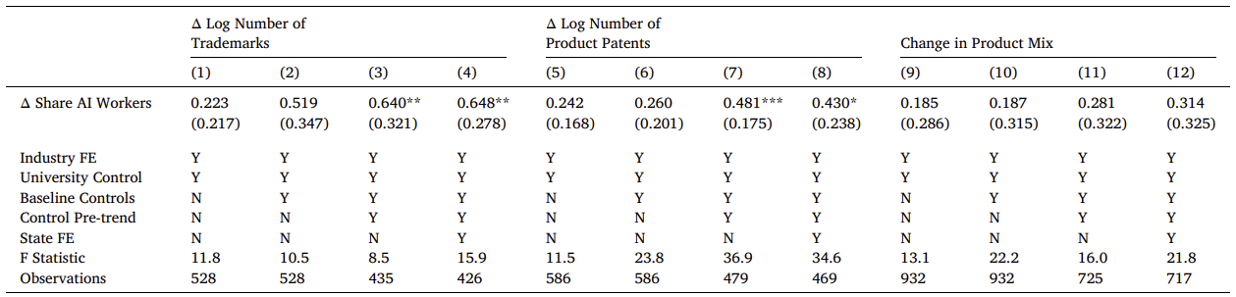
AI as a driver of product innovation
Table 7 AI Investments and Product Innovation: IV Estimates Using the Resume-based AI Measure.
Notes:
Table 7 shows that the instrumented AI investments also have a positive relationship with the number of trademarks, the number of product patents, and the change in product offerings (although not always significant).

Slide 23
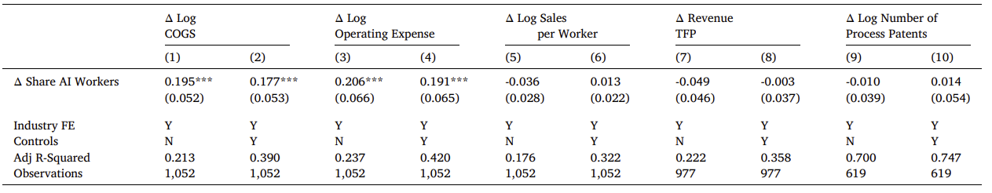
AI as a driver of lower operating costs
Table 8 AI Investments and Operating Costs Using the Resume-based AI Measure.
Overall, the authors find that AI technologies benefit firms through product innovations rather than through reductions in operating expenses or improvements in productivity
Notes:
First, columns 1 to 4 shows that AI investments are associated with increases in costs that are similar in magnitude to increases in firm sales, suggesting that AI is not associated with lower average operating costs.
In columns 5 to 8, the relationship between AI investments and both productivity measures (sales per worker and revenue TFP) is consistently insignificant. The lack of growth in labor productivity is consistent with the results that AI investments predict similar increases in sales and employment, challenging the view that the primary effect of AI so far is to replace jobs.
In columns 9 and 10, We find a zero relationship between AI investments and process innovation, in contrast to the large increase in product patents documented in Table 6

Slide 24
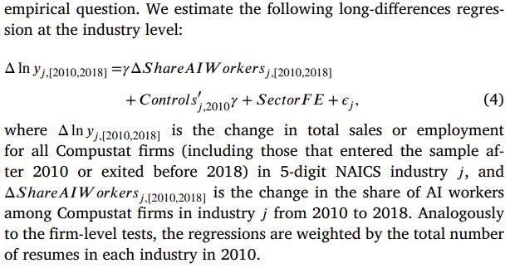
AI investments and industry-level outcomes

Slide 25
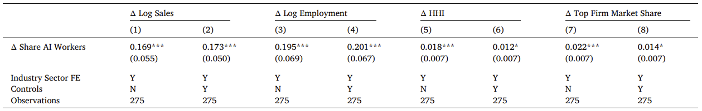
AI investments and industry-level outcomes
Table 9 AI Investments and Changes in Industry Growth and Concentration Using the Resume-based AI Measure.
Notes:
Columns 1 to 4 show that AI investments are associated with a robust increase in employment and sales at the industry level. For example, with the full set of controls, a one-standard deviation increase in the industry-level share of AI workers in the resume data is associated with a 17% increase in sales and a 20% increase in employment.
Columns 5 to 8 show a robust positive relationship between industry-level growth in AI investments and changes in industry concentration.

Slide 26
Conclusions
The authors introduce a novel measure of investments in AI technologies at the firm level using two detailed datasets on human capital: resume data from Cognism, which reveal the actual composition of each firm’s workforce, and job postings from Burning Glass Technologies, which indicate each firm’s demand for particular skills. The unique measure allows to examine both the determinants and the consequences of AI investments by firms across a wide range of sector.
The authors find a positive feedback loop between AI investments and firm size: AI investments concentrate among the largest firms, and as firms invest in AI, they grow larger, gaining sales, employment, and market share. This AI-fueled growth does not appear to stem from cost-cutting; instead, AI-investing firms expand through product innovation and increased product offerings. Our findings highlight important differences between the adoption
The findings highlight important differences between the adoption of AI technologies and the adoption of information technology (IT) in the 1980s and 1990s.
The findings imply that the benefits from AI depend to a large extent on who owns big data—the key input to AI technologies (Fedyk, 2016).

Slide 27
Thank you!

